Slide 1

Why supporting SAIs
enhance
Good governance
Accountability
Transparency
Presented by:
Place and Date:
Notes:
This is a presentation on the importance of supporting Supreme Audit Institutions (SAIs) to enhance good governance, accountability and transparency in the public sector.
The presentation was developed by the INTOSAI-Donor Cooperation, a strategic partnership among the International Organization of SAIs (INTOSAI) and the donor community, whose purpose is to improve SAI performance in developing countries through scaled-up and more effective support.

Slide 2
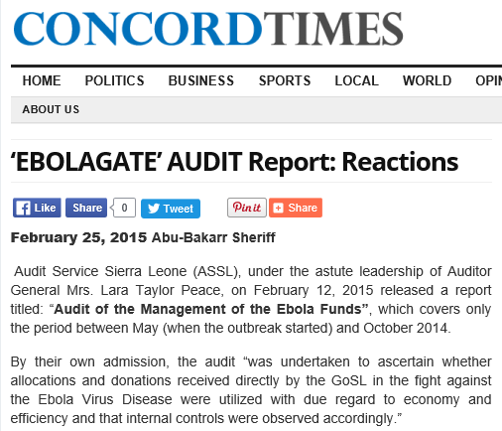

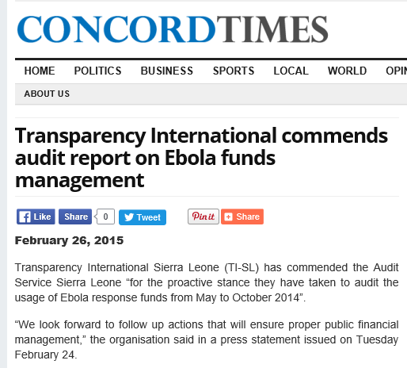
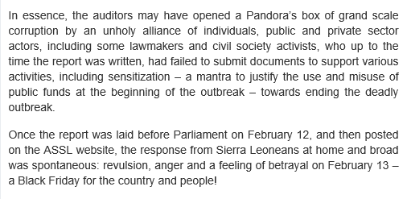
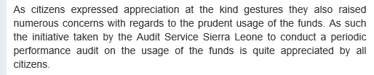
Notes:
(CLICK ON THE PICTURE TO SEE THE FIRST 1 MINUTE 13 SECONDS) Source: Newsy World
As introduction we just saw a news clip published in 2015 about the mismanagement of Ebola funds in Sierra Leone and how the Audit Service Sierra Leone has made an impact on this highly material national topic through carrying out and publishing results of its real time audit.
In addition, as we can observe from the screen shots of the Concord Times newspaper, the initiative demonstrated that the strategy led by the SAI had strong impact, raised awareness on critical issues and managed to engage stakeholders such as the media, CSOs and citizens, putting pressure on government to hold it accountable, recognized corruption problems and promoted change.

Slide 3

In this presentation you will see…
What are Supreme Audit Institutions (SAIs)?
Why are they important to citizens?
Why are they important to development partners?
Why do they need to be supported?
How should they be supported?

Slide 4




What is a Supreme Audit Institution?
By strengthening Supreme Audit Institutions
Promotes the efficiency, accountability, effectiveness and transparency of public administration
Achievement of national development objectives
Importance of SAIs according to UN
Notes:
Explanation of what an SAI is: CLICK ON «WHAT IS A SUPREME AUDIT INSTITUTION» for the 42 seconds video
According to the UN Resolution A/66/209 and 69/228 the strengthening of SAIs will promote efficiency, accountability, effectiveness and transparency in public administration; this will consequently enhance the achievement of national development objectives.
Academic research reasserts that SAIs, among other factors, have positive effects for the quality of government (Rothstein and Tannenberg M., University of Gothenburg 2015)
Sources:
ISSAI 12 http://www.intosai.org/issai-executive-summaries/view/article/issai-12-the-value-and-benefits-of-supreme-audit-institutions-making-a-difference-to-the-liv.html
Tannenberg 2015: http://qog.pol.gu.se/digitalAssets/1549/1549815_the-quality-of-government-and-development-policy.pdf
A/RES/69/228 :http://www.intosai.org/fileadmin/downloads/downloads/0_news/2014/EN_Resolution_69_228.pdf
UN Resolution A/66/209: http://www.intosai.org/news/previous-information/previous-information-2011/010112-un-resolution-a66209.html

Slide 5

In the context of
1. Being models of transparency and accountability
3. Assessing and supporting SDG 16 – strengthening institutions
2. Conducting performance audits of programmes that contribute to SDGs
SAIs contribute to SDGs
Notes:
SAIs not only enhance the achievement of national development objectives but also internationally agreed development goals such as the UN Sustainable Development Goals.
SAIs do so by being models of transparency and accountability,
SAIs can, where mandated, conduct performance audits of national programmes that contribute to SDGs. They can also assess and support SDG 16 – strengthening institutions by publishing relevant audit reports.

Slide 6
What are the benefits when SAIs are supported?
Strengthen SAI Capabilities
PFM Reforms
Sustainable development
Budget or Sector Support
SAIs are natural «allies» for development partners to ensure sustainability, effectiveness and impact of aid efforts
Notes:
SAIs are natural “allies” for development partners to ensure sustainability, effectiveness and impact of aid efforts.
Budget or sector support initiatives, for example, won’t be as effective and efficient as possible if the work of the SAI is not being properly delivered. If funds are misplaced and no one reports on it then efforts are wasted and development initiatives remain unsustainable.
The evidence of this argument follows in the next slides and examples..

Slide 7

of SAIs in their «ally» role

Slide 8



SAI Uganda - providing value and benefits to citizens
Oil has been discovered - production started in 2017
SAI Uganda with support of SAI Norway started preparing in 2014 to ensure that resources from oil:
  Yield as much benefit for Ugandans as possible
  Avoid corruption
  Do not destroy the environment (oil was found in an eco sensitive rich area, within 2 national parks)
SAI Uganda has already presented audit reports of environmental and local economic impact, waste management
Report uncovered a threatening environmental situation in the national park – causing great public debate
Notes:
The first example is the case of SAI Uganda providing value and benefits to citizens. This is envisaged by its active role while publishing audit reports of environmental and local economic impact, and waste management in the oil industry.
Reports have uncovered a threatening environmental situation in the national park. Great debate was encouraged afterwards.
SAI Uganda´s objective is to ensure that resources from oil do not go against Ugandans best interest, that it yields as much as possible but without destroying the environment.
(Source: NORAD video December 2014)
As highlights of the case:
Enhanced SAI support and coordinated aid efforts following the SAI strategy have had results benefiting citizens.

Slide 9


SAI Zambia – impact through public costs savings
SAI Zambia has gone through operational development with the support of SAI Norway and Netherlands since 1997 which has resulted in
Audit reports submitted to parliament within 12 months of the end of the fiscal year (compared
to up to 2‐3 years delays prior to 2003)
Increase in audit coverage from 20‐30% to
70‐75% of all expenditures
As documented by the annual OAG audit reports to parliament, there were substantial reductions in observed mismanagement of public funds
Notes:
The second example is the case of SAI Zambia. After the long-term support received since the end of the 90s decade and beginning of 2000, the SAI has managed to increase coverage and delivery of audit reports and has consequently made an impact.
Reports from The Office of the Auditor General from 2010 indicated that this led to public costs savings and reductions in mismanagement of public funds.
(Source: INTOSAI-Donor Cooperation Stocktaking Report 2010)
As highlights of the case:
Sustainable long-term support enhanced SAI capabilities. Efforts were coordinated through institutional cooperation agreements and multi-donor support

Slide 10
SAI Kenya – contributing to public debt management effectiveness
Audit of lending and borrowing frameworks in 2015-2016:
SAI recommendation:
Carry out competitive recruitment
Finding:
Inadequate staffing at the Public Debt Management Office
Finding:
Poor internal controls for lending and management of contingent liabilities.
SAI recommendation:
Establish task force to determine liability levels
SAI recommendation:
Formal appointment to improve debt management
Finding:
Central Bank acting as fiscal agent without any signed agreement
IMPLEMENTED in 2016
IMPLEMENTED in 2016
IMPLEMENTED in 2016
Notes:
The third example is the case of SAI Kenya which has contributed to public debt management effectiveness after a performance audit that was published and debated in Parliament. Recommendations where approved and implemented, such as the ones seen in this slide.
SAI Kenya did the audit and report while participating in the IDI Global Programme on the Audit of Sovereign Lending and Borrowing Frameworks 2015-2016.
(Source: IDI Performance and Accountability Report 2016 pg.20)
As highlights of the case:
SAI Kenya participation in the IDI programme was harmonized and adjusted to the country needs. SAI Kenya trained itself and delivered audit reports to the high quality needed to get its recommendations approved and thus made an impact relevant for the well being of the citizens.
Up until this moment we have observed a few examples of SAIs in their ally role.

Slide 11

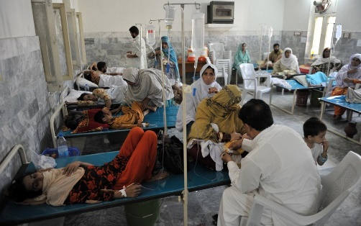


If development partners support sector programs in e.g.
AID efforts are wasted
Education
Health
But
Corruption
Notes:
If development partners are willing to support sector programs for example in education or health, but the levels of corruption in the public sector are too high that distort the effectiveness of the programs; then it means that Aid efforts are wasted.

Slide 12





Unless…
the SAI is strong and able to
Carry out external audit and scrutiny of national and international funds
Detect and deter corruption
Help with costs savings and efficiency in public sector
Strengthen citizen participation by publishing findings
Notes:
Unless the SAI is strong and able to
Carry out external audit and scrutiny of national and international funds: in order to review if they are being used towards their intended purpose in a efficient and effective manner. SAIs serve as in-country systems for managing fiduciary and developmental effectiveness risks
Detect and deter corruption: by creating a strong control framework and increasing the chance of detecting corruption, SAIs can also act as an incentive against corruption.
Help with costs savings and efficiency in public sector: SAIs contribute to development and improved service delivery by reporting issues and enforcing changes. With or without jurisdictional powers, SAIs can encourage and potentially enforce changes when reporting to Parliament and citizens and making recommendations
Strengthen citizen participation: by publishing findings that are understandable and readable for citizens so that they can take an active role in topics of national interest. Thereby strengthening state-society relations, democracy and legitimacy

Slide 13


…Which means that development partners need to support SAIs in building sustainable capabilities for good governance and enhancing efficiency in government institutions…

Slide 14
…because SAIs still struggle with key issues such as independence and audit capacity
Figure 1. Audit Coverage by types of audits per OECD-DAC list and regions
As reported by INTOSAI Development Initiative in its Global SAI Stocktaking Report 2014 - Performance, Capacities and Needs of SAIs…
Figure 2.Percentage of SAIs where budget is presented directly to the legislature (Total, OECD-DAC and regions)
Figure 3. Percentage of SAIs having right to appeal against inadequate budget allocation
Notes:
Because SAIs still struggle with key issues such as independence and audit coverage, as reported by INTOSAI Development Initiative in its Global SAI Stocktaking Report 2014 - Performance, Capacities and Needs of SAIs,
The 2014 Stocktaking assessed results on SAI coverage of audited entities within mandate against a set of specified benchmarks for compliance, financial and Performance Audit. From that, the figure 1. Audit Coverage by types of audit per OECD-DAC list, illustrates that 38% of SAIs from low income countries, for example, indicated that they met these criteria for adequate performance audit coverage, 57% of them indicated that the met the criteria for compliance audit coverage and 69% of them met criteria for financial audit coverage.
In relation to independence, the percentage of SAIs where their budget is presented directly to the Legislature, figure 2., suggest that less than 40% of SAIs operate within a legal framework that enables them to present their budgets direct to their legislatures.
Although these independence constraints may potentially be mitigated provided there are other safeguards in place, such as the right of an SAI to appeal to its legislature against an inadequate budget allocation. Figure 3., shows that, overall, just 55% of all SAI respondents indicated that they could appeal to their legislatures in these circumstances, and this response by income classification shows that, relatively fewer SAIs from Low Income Countries have the right to appeal their budget (39%).
(Source: INTOSAI Development Initiative in its Performance, Capacities and Needs of SAIs-Global SAI Stocktaking Report 2014)
The IDI report is based on information collected from a Global Survey sent to all SAIs worldwide in 2013-2014 (The global survey had a response rate of 84% among SAIs globally ) supplemented with information from PEFA assessments, Open Budget Index, monitoring sample for ISSAI implementation and others

Slide 15

Notes:
So with these compelling arguments presented, why not support SAIs?

Slide 16


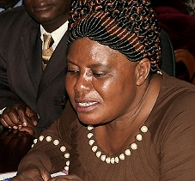





Development partners can then maximize their efforts when…
Strategies are country-led
Sierra Leone
Efforts are coordinated
Zambia
Different Initiatives are harmonized
PASAI
Support is scaled-up
SAI Sierra Leone took the lead to do a real-time audit of the management of Ebola funds - making a strong impact to the future management of resources
SAI Zambia received support from Norway and the Netherlands. Efforts were coordinated through institutional cooperation agreements and multi-donor support
Support to SAIs has been harmonized with the strategic direction of the Pacific Organization of Supreme Audit Institutions
  Bhutan
SAI Bhutan has accessed support through Cooperation initiatives
Notes:
Development Partners can maximize their efforts when:
- Strategies are country-led as example SAI Sierra Leone in the case of the Ebola Funds
- Efforts are coordinated such as in SAI Zambia making impact thanks to aid effors been coordinated
- Different Initiatives are harmonized as example the Pacific Association of Supreme Audit Institutions (PASAI) where support has been harmonized to the strategic direction of the region
Support is scaled-up such as SAI Bhutan which has accessed to scaled-up support through Cooperation initiatives
These constitute the key principles for effective SAI capacity development.
They came out of a recognition that support to SAIs is partly characterised by uncoordinated support from both donors and other SAIs, that the priorities of those providing support were followed rather than the priorities of the SAIs themselves, and in many cases SAIs lacking a clear strategic direction. So even where there was funding available, sometimes the support had limited results.

Slide 17
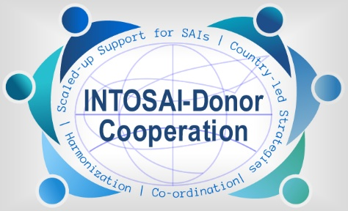
This is when the INTOSAI-Donor Cooperation comes into play…
The INTOSAI-Donor Cooperation is a strategic partnership between donors and the Supreme Audit Institution (SAI) community.
Purpose: to improve SAI performance in developing countries through scaled-up and more effective support.
Guiding Principles: development of country-led strategic plans; donors respecting SAI country leadership; and improved coordination of support.
Members: To date, 23 donor organizations and INTOSAI have signed the Memorandum of Understanding.
For more information, visit us online at www.idi.no/intosai-donor-cooperation
Notes:
The previously mentioned reasons motivated in 2010 the signature of a Memorandum of Understanding between donors and INTOSAI, called INTOSAI-Donor Cooperation, which purpose is to improve SAI performance in development countries through the application of the principles mentioned in the previous slide.
To date, 23 donor organizations and INTOSAI have signed the Memorandum of Understanding

Slide 18
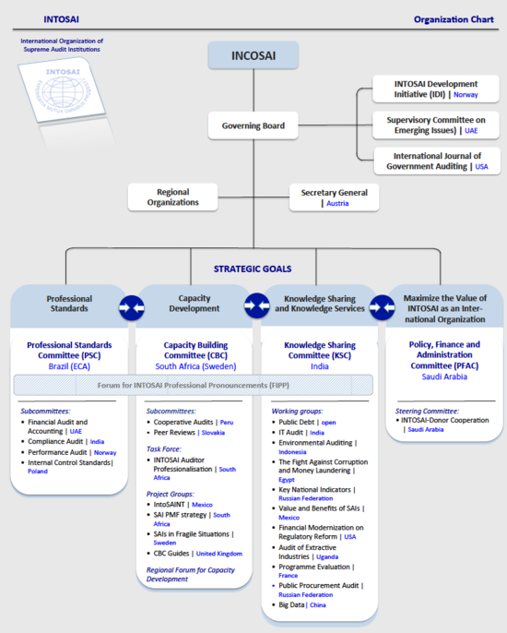

The International Organisation of Supreme Audit Institutions (INTOSAI) operates as an umbrella organisation for the external government audit community.
It provides an institutionalised framework for supreme audit institutions to promote development and transfer of knowledge, improve government auditing worldwide and enhance professional capacities, standing and influence of member SAIs in their respective countries.
INTOSAI is an autonomous, independent and non-political organisation. It is a non-governmental organisation with special consultative status with the Economic and Social Council (ECOSOC) of the United Nations.
Notes:
INTOSAI is the international organization of SAIs – with over 190 members. It has a number of committees, including regional and thematic working groups, that work together to improve public sector auditing.

Slide 19
So please remember…
SAIs enhance accountability and transparency of public institutions
SAIs are natural «allies» for development partners to ensure sustainability, effectiveness and impact of aid efforts
SAIs provide direct benefits to citizens by fighting corruption and preventing mismanagement of resources
SAIs need support as they still struggle with independence and audit capacity
Development partners can help by..
Scaling-up support
Harmonizing efforts
Coordinating donor initiatives
Working under the SAI Strategic Plan

Slide 20
Thank you!
www.idi.no/intosai-donor-cooperation
intosai.donor.secretariat@idi.no

